Slide 1
ENDLESS RUNNER
Team:
Đỗ Minh Khôi - 21521007
Nguyễn Quang Vũ - 21522801
Nguyễn Nguyên Khôi - 21521009

Slide 2
Agenda
1.
Introduction
2.
Character & objects
3.
Transformations
4.
Illumination & shadowing
5.
Sound & scoring
6.
Demo video

Slide 3
Introduction
Endless Runner is a game in which a character runs on a infinite road surrounded by buildings. Gamer controls the character, tries to avoid obstacles and accumulates as many points as possible
Inspired by: Subway Surfer, Temple Run

Slide 4

Character & objects
Road
A straight road where the character runs and obstacles are randomly spotted
Created with THREE.BoxGeometry and road texture

Slide 5
Character & objects
Sidewalk
Created with THREE.BoxGeometry and brick texture
There are two sidewalks on the left and right where the buildings stay

Slide 6
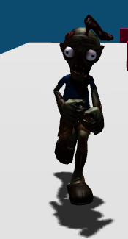
Objects
Character:
Controlled by the gamer
Runs endlessly and avoid obstacles
Originally an FBX model, downloaded from Mixamo
Controlled by 3 keys 'a', 'd' and space to avoid obstacles and remain on the road
If the character collides with any obstacle or runs out of the road, the game is over.

Slide 7
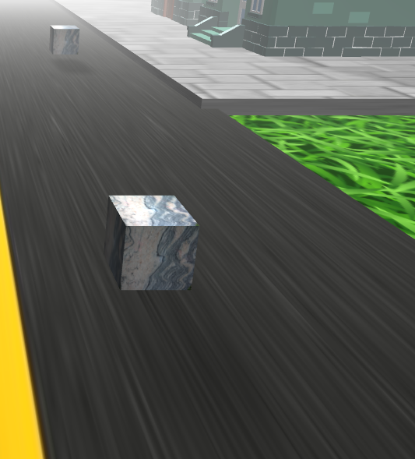
Character & objects
Obstacles:
Cubes with marble texture
Continuously spotted at random coordination (but very far ahead) with increasing frequency

Slide 8
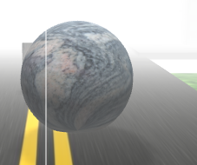
Character & objects
Obstacles:
Large spheres with marble texture makes the game much more challenging
Continuously spotted at random coordination (but very far ahead) with increasing frequency
1 sphere is surrounded by multiple cubes

Slide 9
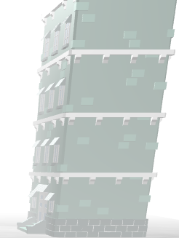
Character & objects
Buildings:
Stand on either sidewalk
Types: 1-story, 2-story, 4-story, 6-story
Originally FBX models

Slide 10
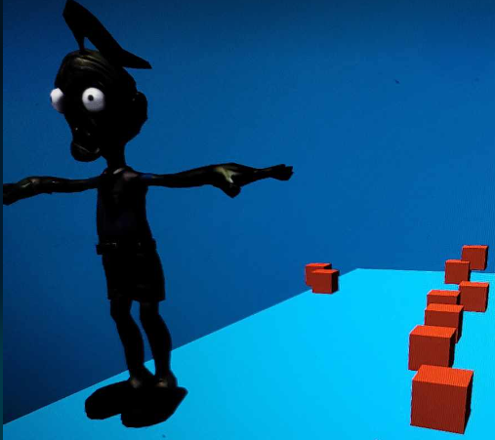
Transformations
Scale:
The character is a large-sized FBX model ==> scale down with a rate of 0.01

Slide 11
Transformations
Character translation:
Key “a”: the character will move left along Ox​
Key “d”: the character will move right along Ox​
Spacebar: the character will move up and down along Oy (jumping motion), only once with each press.
The character automatically moves forward along Oz
The character automatically falls down when completely off the road surface

Slide 12
Transformations
Obstacle translation:
Appearance: automatically fall onto the road surface from a distant coordinate from the camera's perspective
The obstacle is elastic and bounces several times before coming to rest on the road surface
Obstacles automatically move towards the character along the Oz axis

Slide 13
lllumnination
DirectionalLight: Help to shade the character and obstacles
AmbientLight: Help illuminate every position of each object
Spotlight: Applied to the character
Fog to be applied to an obj when 1 < d(obj, camera) < 60 units

Slide 14
Sound & Scoring
Menu Sound: Temple Run’s menu theme song
Game Sound: Temple Run’s Whimsy Wood
Score: +10 for every step forward the character makes

Slide 15

Demo

Slide 16
Development path
Store the score after each game to find the current record
Add falling animation for the character
Delay a few seconds when the character collides with any obstacle

Slide 17
References
[1] FBX Model Loader, Three.js Tutorials, SBCODE
[2] Box3, Three.js docs
[3] Github, ThreeJS_Tutorial_CharacterController
[4] Youtube, Three.js 3D Game Tutorial
[5] Mixamo
[6] ChatGPT
[7] Microsoft Copilot

Slide 18
Q&A

